Slide 1


User-cloud-based ensemble framework for type-2 diabetes prediction with diet plan suggestion
COMPUTER SCIENCE AND ENGINEERING
Presented By:
S. Rishitha Gangothri (B21CS103) E. Shiva Kumar (B21CS102)
J. Nithish (B21CS123)
G. Siddarth (B21CS075)
Under the Supervision of:
P. Sreenivas
Assistant professor

Slide 2
CONTENTS
OBJECTIVES & OUTCOMES
ALOGORITHM
FLOW CHART
DATASET
USER INTERFACE
CONCLUSION
REFERENCES

Slide 3
OBJECTIVES
Develop a robust system for diabetes prediction using an ensemble of ML models.
Implement a cloud-based infrastructure for scalable data processing.
Create a personalised diet plan suggestion system based on prediction outcomes.
OUTCOMES
Improved accuracy in diabetes detection.
Real time accessibility to health predictions and diet plan via cloud servers.
Enhanced user engagement and health management.

Slide 4
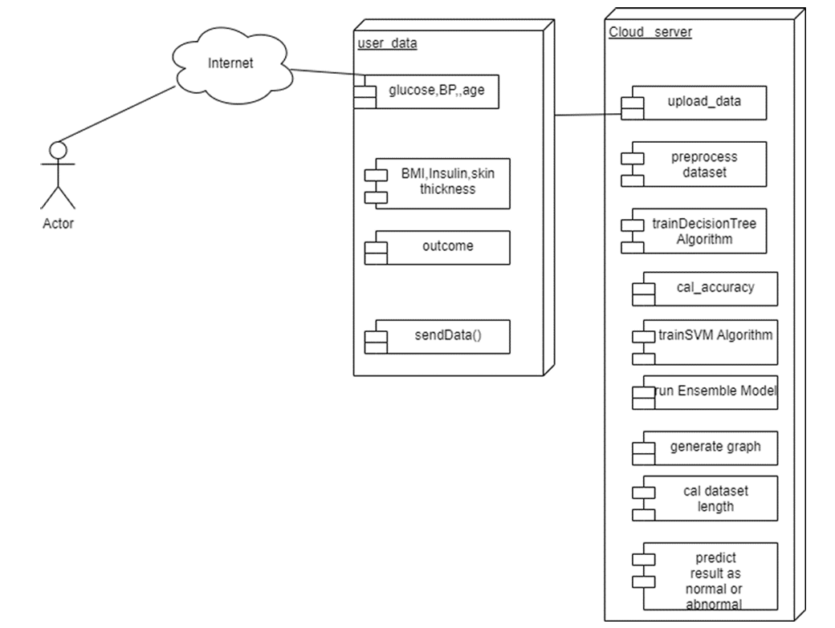
FLOW CHART

Slide 5
DATASET
Features:
Pregnancies: Number of pregnancies.
Blood Pressure: Diastolic blood pressure (mm Hg)
Skin Thickness: Triceps skin fold thickness (mm).
Insulin: Serum insulin levels (mu U/ml).
BMI: Body mass index (kg/m²).
Diabetes Pedigree: Genetic predisposition score.
Age: Patient age
Outcome: 0 (non-diabetic) or 1 (diabetic).
Application: Data split into training and testing sets for model evaluation.

Slide 6
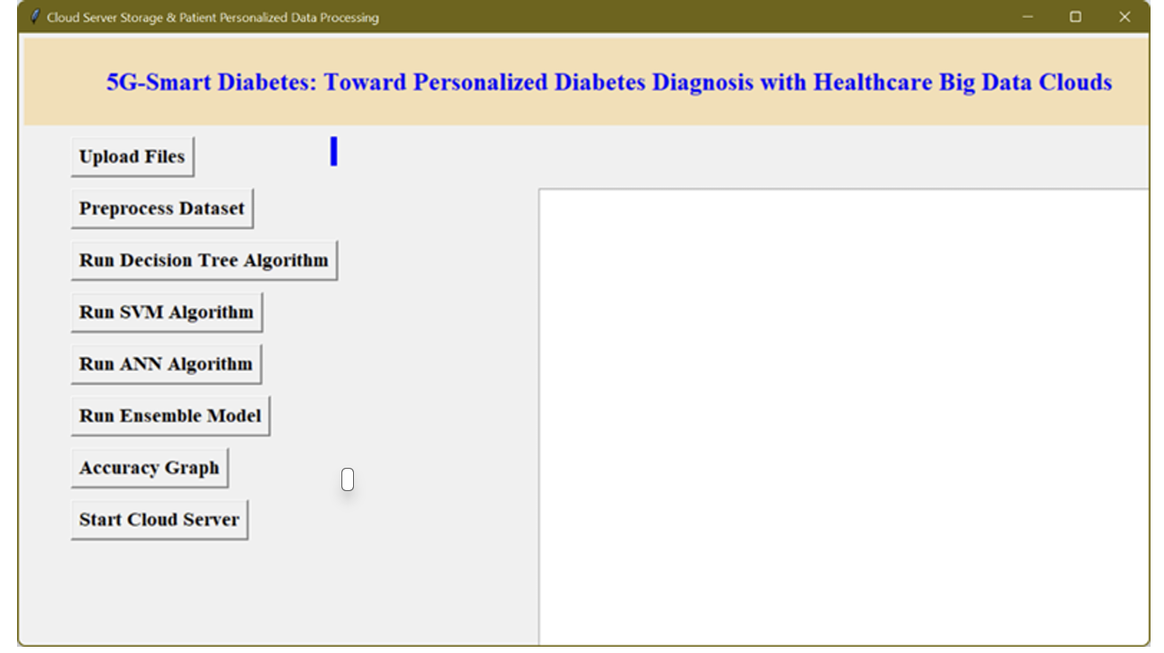
User Interface

Slide 7
Key Components:
Login/Registration: Secure access for users to manage their profiles.
Dashboard: Displays patient data, predictions, and health metrics.
Data Upload Section: Allows users to upload test data (e.g., glucose readings).
Results Visualization: Graphs and charts to show glucose levels, trends, and predictions.
Diet Plan Recommendations: Personalized suggestions based on user data

Slide 8
CONCLUSION
The research paper presents a cloud-based ensemble framework, DP-UCE, designed for predicting Type-2 diabetes and suggesting diet plans. By using a hybrid approach that combines decision tree classifiers, support vector machines, and artificial neural networks within a cloud environment, the framework offers improved accuracy. The model achieves 87.41% accuracy on the Pima Indian Diabetes dataset, outperforming traditional methods. This innovation not only enhances prediction capabilities but also ensures user accessibility by integrating the system into everyday environments, making diabetes management more proactive and personalized.

Slide 9
REFERENCES
User-cloud-based ensemble framework for type-2 diabetes prediction with diet plan suggestion- https://www.sciencedirect.com/science/article/pii/S2772671124000056
Ensemble framework-based diabetes detection and diet plan suggestion for healthcare big data clouds- https://www.jcdronline.org/admin/Uploads/Files/64a90003d2c1f0.62894228.pdf
Diabetes detection and diet plan suggestion for health care using bigdata clouds - https://historymedjournal.com/uploads/paper/ffa8837ddfa16c3d9b4c8cd32cb76b1d.pdf
Pima Indians Diabetes Database- https://www.kaggle.com/datasets/uciml/pima-indians-diabetes-database

